Slide 1
Steps to finish the Touch Base program
In this example, there are four Sprites staying at the four corners of the stage. These four Sprites take turns to go to the next Sprite, like passing a baton to it, and form a continuous anticlockwise flow. After touching the its next Sprite, it will glide back to its own corner. The backdrop has nothing to do with their actions, and was chosen for fun.

Slide 2
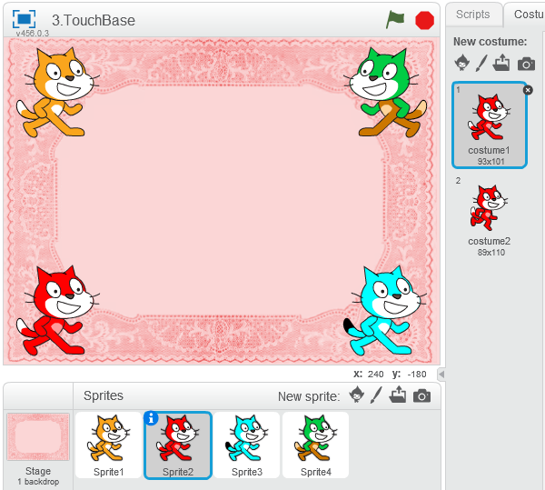
Colouring the Sprites
You can use Sprites of different shapes. In our demonstration, we simply use four Sprite cats. When you add more cats to the stage, they will have different names, Sprite2, Sprite 3, and so on. But we think it is not enough to tell them apart. We will colour the Sprites to make them look more different.
Go to the Costume pane of the Sprites. Locate the paint tools on the right hand side. Freely draw on the Sprites, or use the Paint Bucket to colour the skin quickly. Use the Help icon to help you get familiar with the paint tools.
Paint or draw on both costumes in the same way, as we will use both costumes.

Slide 3
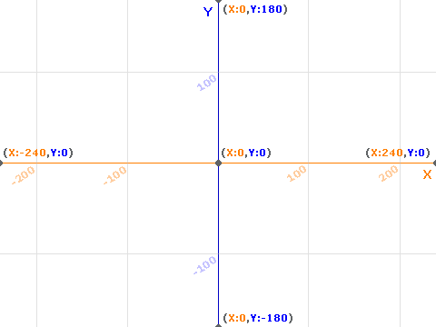
Sprites setup
Bring the four Sprites to the four corner. After fixing the position for one Sprite, it is easy to use the go-to instruction block and fix the positions of the other Sprites with coordinates.
If you are neat, and you find it good to have Sprite1 at (-180, 120), the other Sprites should be placed at (-180, -120), (180, -120), and (180, 120) respectively, for a symmetric layout. There is no maths to do. You just need to switch between positive and negative numbers. If you are not a neat person, just place them somewhere near the corners that looks good to you.
It will be more convenient in the later steps if you can arrange the Sprites in order, that is, Sprite1, then Sprite2, Sprite3, and Sprite4 in anticlockwise order.
Set the rotation styles to be left-right.

Slide 4
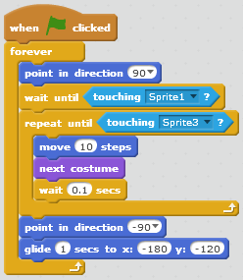
Sprites 2 to 4
Go to the Scripts pane of Sprite2 and gather the below blocks.
You should have the correct coordinates if you drag out the glide-to instruction after the Sprite is placed at a desired position.
Now you can see that if you arrange the Sprites in order, it will save you some time to decide which Sprite it should wait on, and which it should touch after.

Slide 5
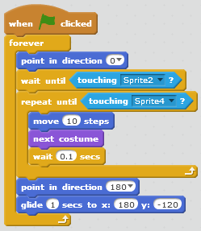
Sprites 2 to 4
2. Below are the blocks for Sprite3.

Slide 6
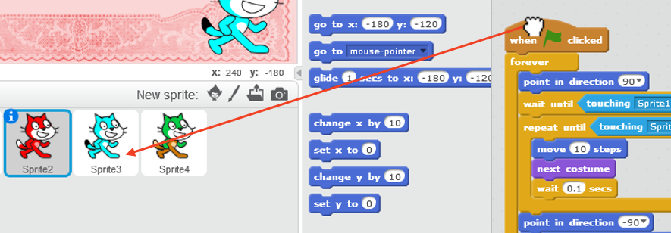
Sprites 2 to 4
It will be good to know that you can copy code blocks across Sprites by dragging the blocks onto the Sprite icon, like this:
But you should note that after copying, you should make changes for (1) the directions to point, there are two such instructions, (2) the name of the Sprite that will touch it (the wait-until), (3) the name of the Sprite that it will touch (the repeat-until), and (4) the glide-to position.

Slide 7
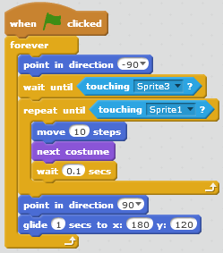
Sprites 2 to 4
3. Below are the blocks for Sprite4.

Slide 8
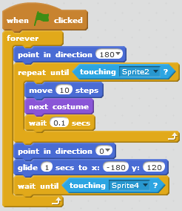
Sprite1
We just told you to gather the code for Sprite2 to Sprite4, because, if you do the same for Sprite1 too, no Sprites will actually move! All of them will be waiting to be touched.
For Sprite1, gather the below code blocks.
It is essentially the same blocks, but the order is changed a little. It will move first, before doing the waiting, in order to start the flow.
This program runs forever.

